Slide 1
Chapter-3.1 Transmission Media
Prepared By:
Er.Rabindra Phoju
Lecturer,Khec

Slide 2
Transmission medium
Physical path between transmitter and receiver
May be guided (wired) or unguided (wireless)
Communication achieved by using EM waves
The physical path over which the information flows from transmitter to receiver is called the transmission medium or the channel.

Slide 3
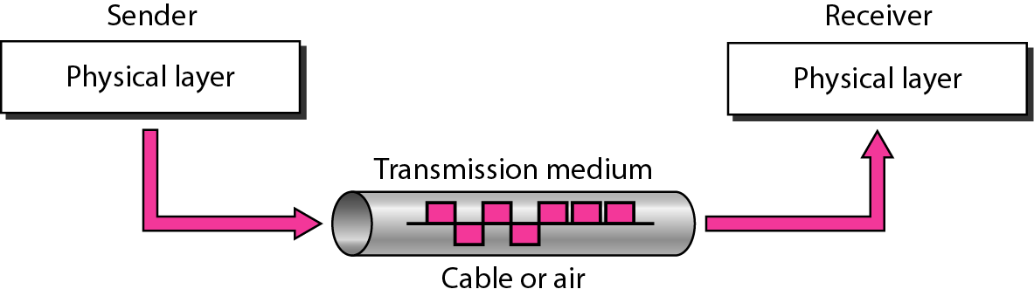
Figure :Transmission medium and physical layer

Slide 4
Characteristics and quality of data transmission
Dependent on characteristics of medium and signal
1. Guided medium
Medium is more important in setting transmission parameters i.e Quality of transmission will be Primarily determined by transmission media
Charx. of medium: BW of media,signal to noise ratio,attenuation
2.Unguided medium
- Bandwidth of the signal produced by transmitting antenna is important in setting transmission parameters
- Signal directionality
* Lower frequency signals are omni-directional
* Higher frequency signals can be focused in a directional beam

Slide 5
DESIGN FACTORS DETERMINING DATA RATE AND DISTANCE
Bandwidth
higher bandwidth gives higher data rate
transmission impairments
impairments, such as attenuation, limit the distance
interference
overlapping frequency bands can distort or wipe out a signal
number of receivers
more receivers introduces more attenuation

Slide 6
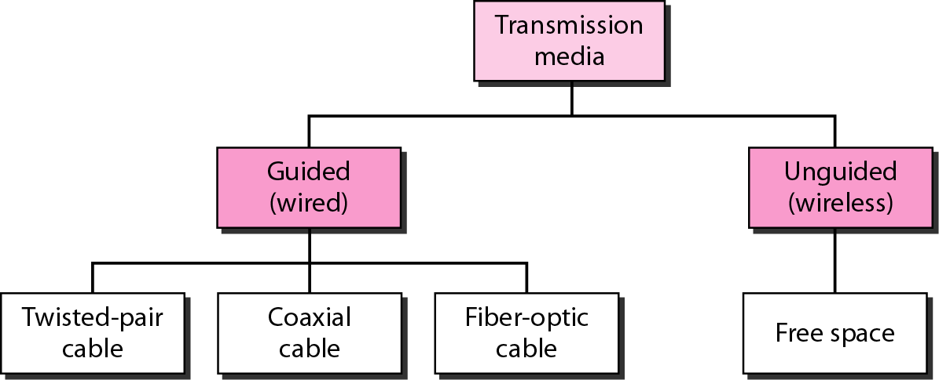
Figure : Classification of transmission media

Slide 7
Classification of Transmission Media:
Two categories:
1.Guided media
- guided along a solid media
-Transmission capacity (bandwidth and data rate) depends on distance and type of network (point-to-point or multipoint)
Ex : twisted pair, copper coaxial cable, and optical fiber.
2. Unguided media
- atmosphere and outer space
- provides a means for transmitting electro-magnetic signals through air but do not guide them.
Ex: wireless broadcast channels, mobile radio channels, and satellite channels

Slide 8
Guided:Twisted pair
-Least expensive and most widely used
Physical description
* Two insulated copper wires arranged in regular spiral pattern
* Number of pairs are bundled together in a cable
* Twisting decreases the crosstalk interference between adjacent pairs in the cable, by using different twist length for neighboring pairs

Slide 9
Applications
* Most common transmission media for both digital and analog signals
* Less expensive compared to coaxial cable or optical fiber
* Limited in terms of data rate and distance
* Telephone network
- Individual units (residence lines) to local exchange (end office)
-Subscriber loops
- Supports voice traffic using analog signaling
-May handle digital data at modest rates using modems
* Communications within buildings
-Connection to digital data switch or digital pbx within a building
-Allows data rate of 64 kbps

Slide 10
Transmission characteristics
* Requires ampliers every 5-6 km for analog signals
* Requires repeaters every 2-3 km for digital signals
* Attenuation is a strong function of frequency
- Higher frequency implies higher attenuation
* Susceptible to interference and noise
* Improvement possibilities
- Shielding with metallic braids or sheathing reduces interference
- Twisting reduces low frequency interference
- Different twist length in adjacent pairs reduces crosstalk

Slide 11
Unshielded and shielded twisted pairs
1. Unshielded twisted pair (UTP)
*Ordinary telephone wire
* Subject to external electromagnetic interference
2. Shielded twisted pair (STP)
*Shielded with a metallic braid or sheath
* Reduces interference
* Better performance at higher data rates
* More expensive and dicult to work compared to UTP

Slide 12
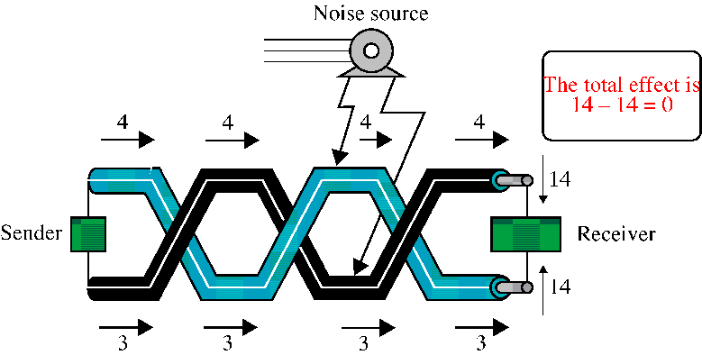
Guided:Twisted-Pair Cables
If the pair of wires are not twisted, electromagnetic noises from, e.g., motors, will affect the closer wire more than the further one, thereby causing errors

Slide 13
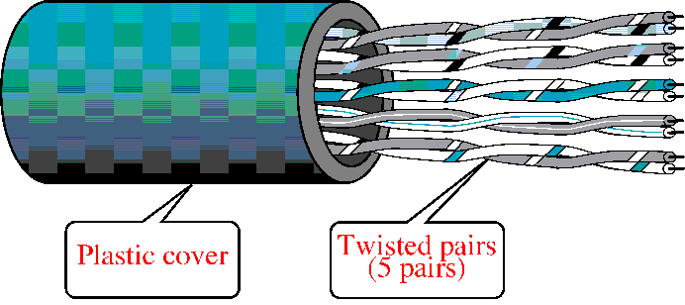
Unshielded Twisted-Pair (UTP)
Typically wrapped inside a plastic cover (for mechanical protection)
A sample UTP cable with 5 unshielded twisted pairs of wires
Insulator
Metal

Slide 14
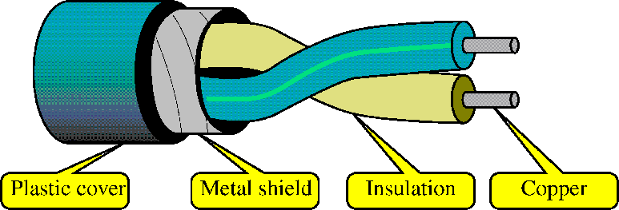
Shielded Twisted-Pair (STP)
STP cables are similar to UTP cables, except there is a metal foil or braided-metal-mesh cover that encases each pair of insulated wires

Slide 15
Categories of unshielded twisted-pair cables

Slide 16
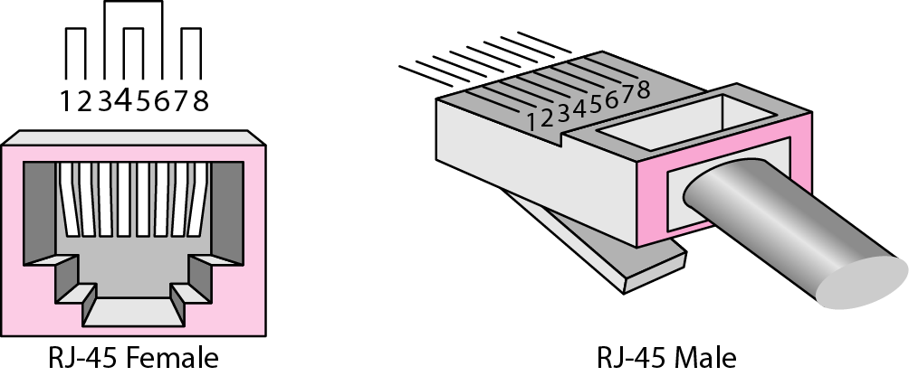
Figure . UTP connector

Slide 17
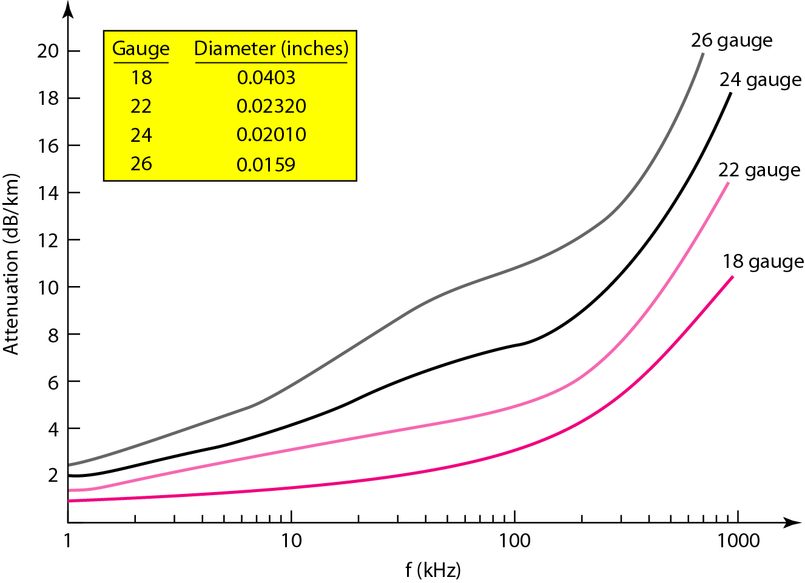
Figure : UTP performance

Slide 18
Advantages and Disadvantages of Twisted pair
Advantages
Disadvantages
1.High availability
2.Low cost of installation on premises
3.Low cost for local moves, adds, and changes in places
1. Limited frequency spectrum
2. Limited data rates
3. Short distances required between repeaters—
4. High error rate

Slide 19
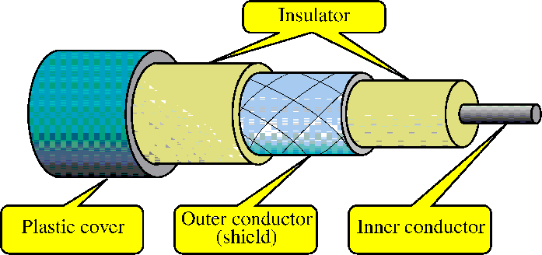
Coaxial Cables
In general, coaxial cables, or coax, carry signals of higher freq (100KHz–500MHz) than UTP cables
Outer metallic wrapping serves both as a shield against noise and as the second conductor that completes the circuit

Slide 20
Coaxial Cable: Physical description
* Consists of two conductors with construction that allows it to operate over a wider range of frequencies compared to twisted pair
*Hollow outer cylindrical conductor surrounding a single inner wire conductor
* Inner conductor held in place by regularly spaced insulating rings or solid dielectrical material
* Outer conductor covered with a jacket or shield
* Diameter from 1 to 2.5 cm
* Shielded concentric construction reduces interference and crosstalk
* Can be used over longer distances and support more stations on a shared line than twisted pair

Slide 21
Applications
*Most common use is in cable tv
* Traditionally part of long distance telephone network
* Can carry more than 10,000 voice channels simultaneously using frequency-division multiplexing
* Short range connections between devices

Slide 22
Transmission characteristics
*Used to transmit both analog and digital signals
* Superior frequency characteristics compared to twisted pair
* Can support higher frequencies and data rates
* Shielded concentric construction makes it less susceptible to interference and crosstalk than twisted pair
* Constraints on performance are attenuation, thermal noise, and inter-modulation noise
* Requires amplifiers every few kilometers for long distance transmission
* Usable spectrum for analog signaling up to 500 MHZ
* Requires repeaters every few kilometers for digital transmission
* For both analog and digital transmission, closer spacing is necessary for higher frequencies/data rates

Slide 23
Categories of coaxial cable
For data applications, it is classified into two categories: thick coax or 10Base5, and thin coax or 10Base2.
In this designation, the 10 refers to the transmission speed of 10 Mbps, the Base
refers to baseband signaling, and the 2 and 5 refer to the coaxial cable maximum segment length in meters.
For instance, in 10Base2, the 2 refers to 200 m (185 m has been rounded off to 200 m).

Slide 24
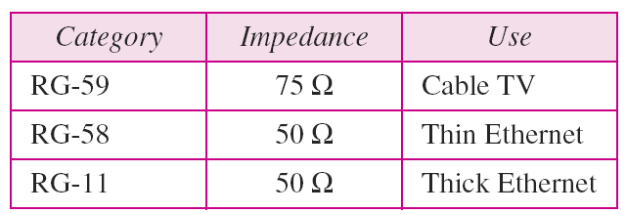
Table : Categories of coaxial cables

Slide 25
RG-11, RG-58 and RG-59 these are the three popular coaxial cables commonly used in three different applications :
RG-59 is commonly used in cable TV which is very popular and is of low cost.
RG-58 with characteristic impedance of 50 ohms that means the cables are to be transmitted are to be terminated by 50 ohms resistance and that is used in thin Ethernet which gives a data rate of 10 Mbps.
RG 11 is thick Ethernet with characteristic impedance fifty ohms also used in thick Ethernet .

Slide 26
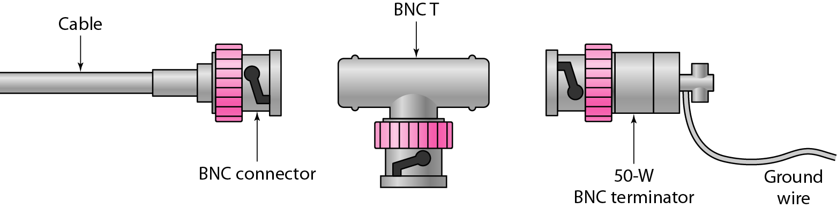
Figure : BNC(Bayone-neill-Concelman) connectors

Slide 27
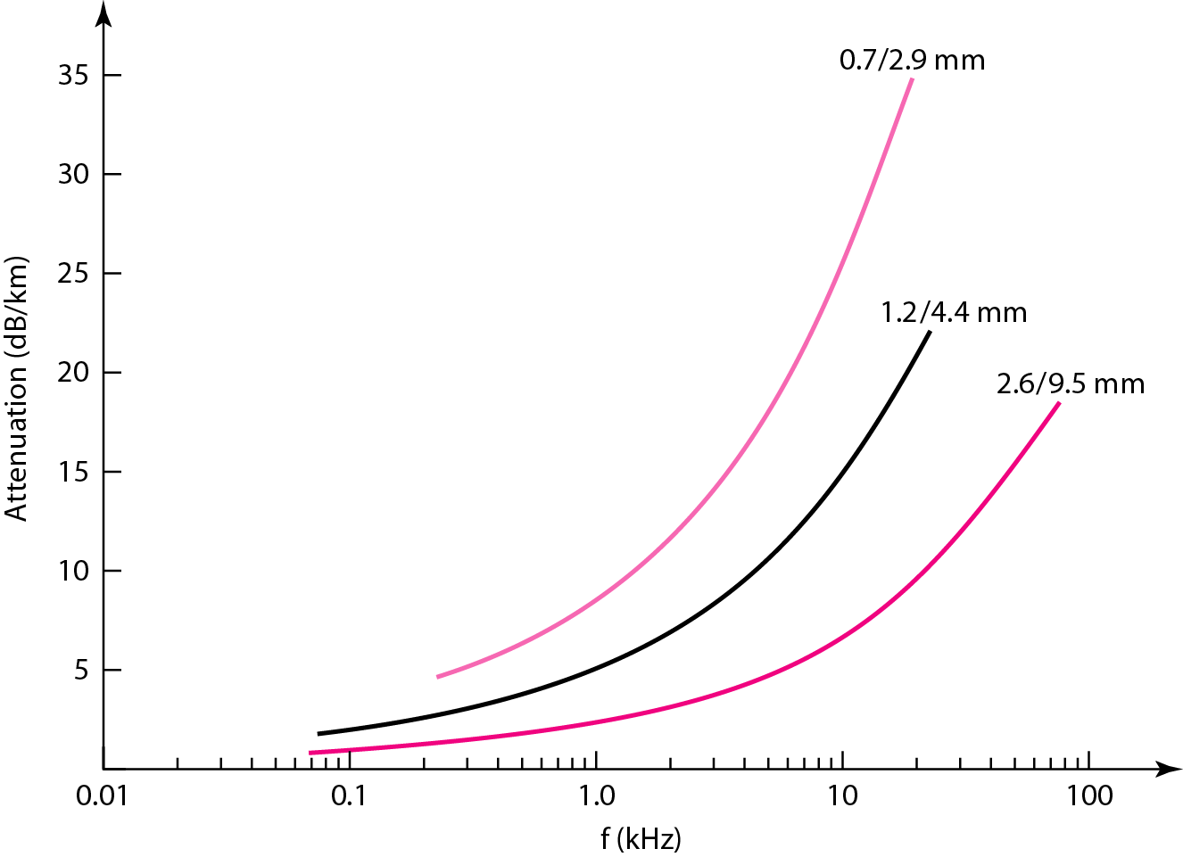
Figure : Coaxial cable performance

Slide 28
Optical fiber
Thin, flexible material to guide optical rays
Cylindrical cross-section with three concentric links
1. Core
* Innermost section of the fiber
* One or more very thin (dia. 8-100 m) strands or fibers
2. Cladding
* Surrounds each strand
* Plastic or glass coating with optical properties different from core
* Interface between core and cladding prevents light from escaping the core
3. Jacket
* Outermost layer, surrounding one or more claddings
* Made of plastic and other materials
* Protects from environmental elements like moisture, abrasions, and crushing

Slide 29
Comparison with twisted pair and coaxial cable
1. Capacity
- Much higher bandwidth
- Can carry hundreds of Gbps over tens of kms
2. Smaller size and light weight
- Very thin for similar data capacity Much lighter and easy to support in terms of weight (structural properties)
3. Significantly lower attenuation
4. EM isolation
-Not affected by external EM fields
-Not vulnerable to interference, impulse noise, or crosstalk
-No energy radiation; little interference with other devices; security from eavesdropping
5. Greater repeater spacing
- Lower cost and fewer error sources

Slide 30
COPPER VERSUS FIBER
Optical fibers have several advantages over copper cables: immunity to EMI, lighting, electrical discharges, and crosstalk, no electrical ground loop or short circuit problems, and resistance to nuclear radiation and high temperatures.
Also, there is no electrical hazard when a fiber-optic cable is cut or damaged.
More importantly, a fiber can carry thousands of times more information than can a copper wire of the same size.
Optical fiber cables are lighter and take less space than copper cables for the same information capacity.

Slide 31
COPPER VERSUS FIBER
Fibers also have longer cable runs between repeaters because a signal loses very little strength as it travels down a fiber, as compared with copper.
Optical fiber losses are independent of the transmission frequency on a network; there is no crosstalk that can degrade or limit the performance of fiber as network speeds increase.
As a result of the crucial advantages that fiber offers over copper, it is often used in backbone wiring, noisy environments such as factory floors, and security-conscious installations like military and banking

Slide 32
Applications
Because of greater bandwidth (2Gbps), smaller diameter, lighter weight, low attenuation, immunity to electromagnetic interference and longer repeater spacing, optical fiber cables are finding widespread use in long-distance telecommunications.
Especially, the single mode fiber is suitable for this purpose.
Fiber optic cables are also used in high-speed LAN applications.
Multi-mode fiber is commonly used in LAN.

Slide 33
Applications
1. Long haul trunks
* Increasingly common in telephone networks
* About 1500km in length with high capacity (20000 to 60000 voice channels)
2. Metropolitan trunks
* Average length of about 12 km with a capacity of 100,000 voice channels
* Mostly repeater less to join phone exchanges in metro areas

Slide 34
Applications
3. Rural exchange trunks
*Circuit lengths from 40 to 160 km
*Fewer than 5000 voice channels
*Connect exchanges of different phone companies
4. Subscriber loops
*Central exchange to subscriber
* May be able to handle image and video in addition to voice and data
5. Local area networks
* 100Mbps to 1Gbps capacity
* Can support hundreds of stations on a campus

Slide 35
Transmission characteristics
* Single-encoded beam of light transmitted by total internal reflection
* Transparent medium should have higher refractive index compared to surrounding medium
Refractive Index - The ratio of the speed of light in a vacuum to the speed of light in a medium under consideration
* Optical fiber acts as a waveguide for frequencies in the range of about 10^14 to 10^15 Hz (IR and visible regions of spectrum)

Slide 36
Multimode transmission
Allows for multiple propagation paths, with different path lengths and time to traverse the fiber
Signal elements can be spread over time
Limits the rate at which data can be accurately received
Best suited for transmission over very short distances.
Multimode step- index
Multimode graded- index

Slide 37
Multimode step- index fiber
the density of the core remains constant from the
center to the edges. A beam of light moves through this constant density in a straight
line until it reaches the interface of the core and the cladding. At the interface, there is
an abrupt change due to a lower density; this alters the angle of the beam's motion. The
term step index refers to the suddenness of this change, which contributes to the distortion
of the signal as it passes through the fiber.

Slide 38
Graded-index multimode
Lies in between single-mode and multimode
Higher refractive index at the center implies that the rays close to axis advance slowly compared to rays close to the cladding
Light in the core curves helically reducing its traveling distance (does not zig zag off the cladding)
Shorter path and higher speed makes light at periphery as well as at the axis travel at the same

Slide 39
Single-mode transmission
Reduced fiber core will allow fewer angles to be reflected
Single transmission path reduces distortion
Typically used for long-distance applications
The singlemode fiber itself is manufactured with a much smaller diameter than that of multimode fiber, and with substantially lower density (index of refraction).
The decrease in density results in a critical angle that is close enough to 90° to make the propagation of beams
almost horizontal.
In this case, propagation of different beams is almost identical, and delays are negligible.
All the beams arrive at the destination "together" and can be recombined with little distortion to the signal

Slide 40
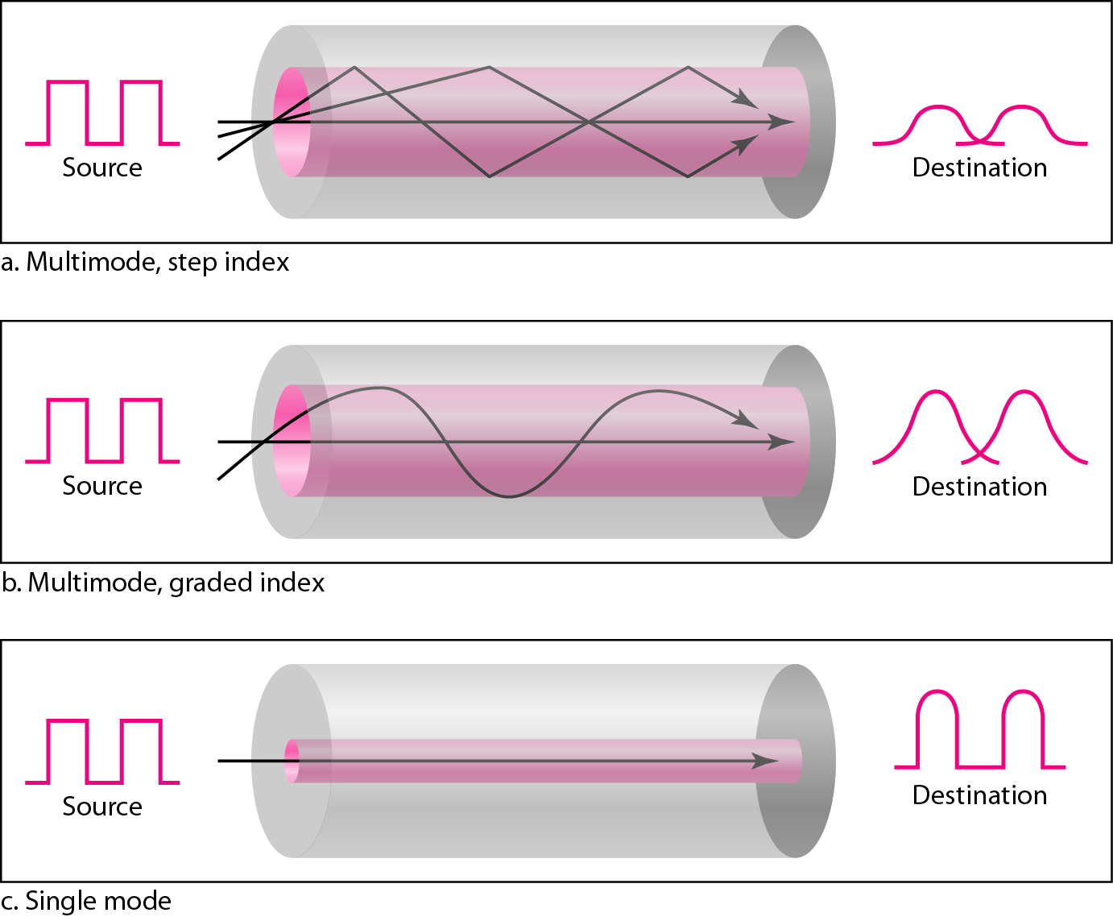
Figure . Modes

Slide 41
Table . Fiber types

Slide 42
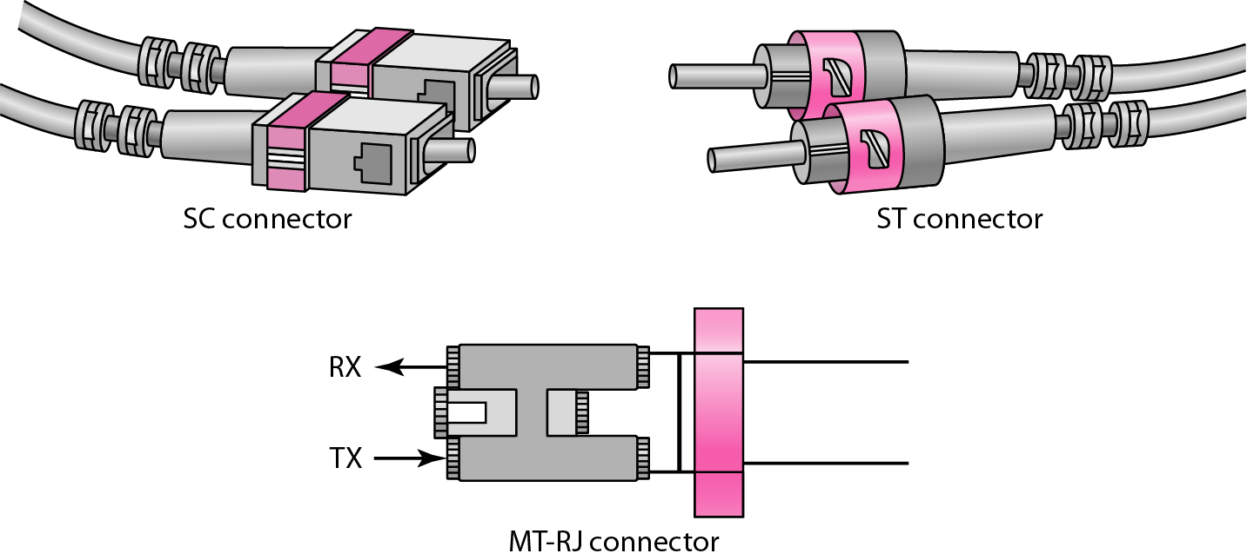
Figure . Fiber-optic cable connectors

Slide 43
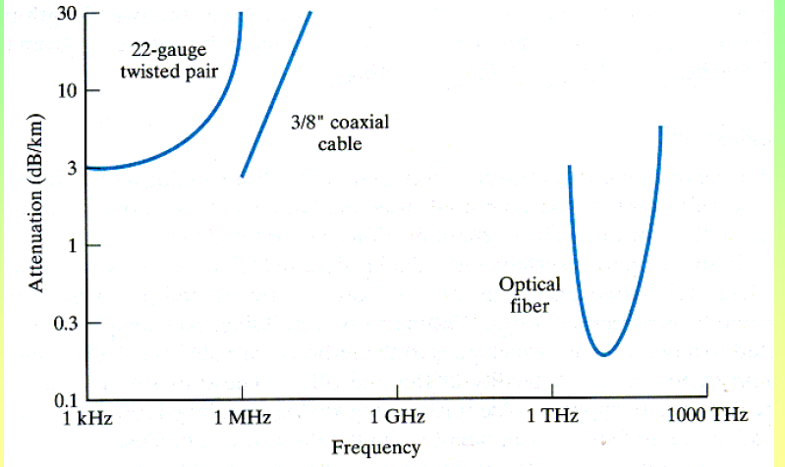

Slide 44
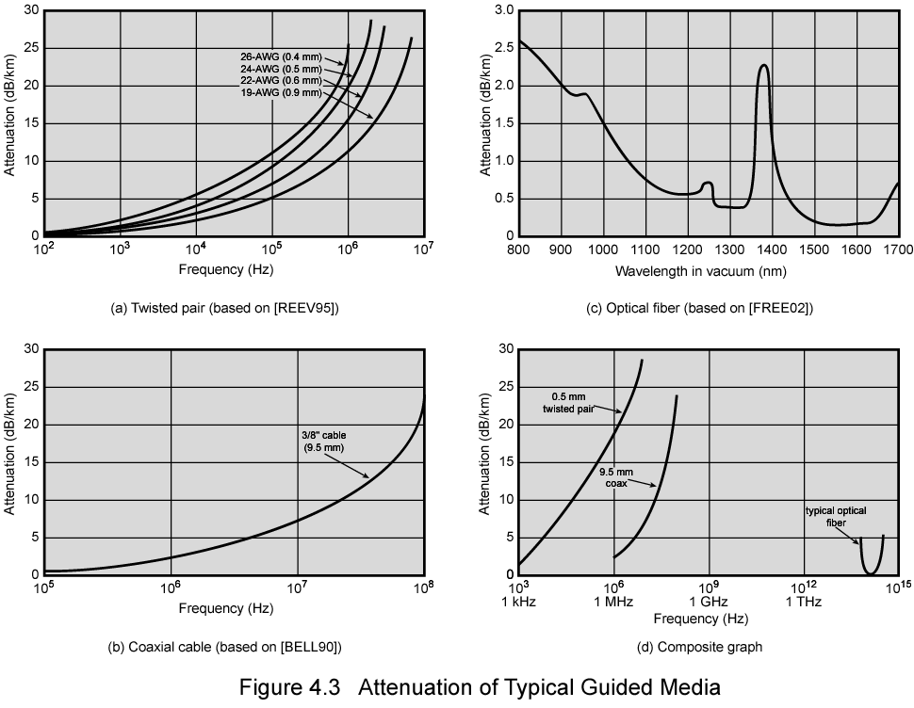
Attenuation in Guided Media

Slide 45
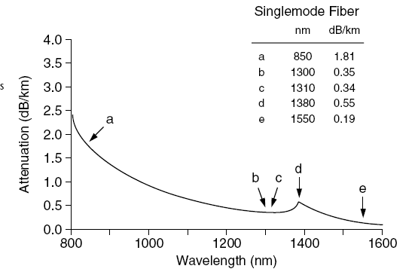
Attenuation curve of Single mode Fiber

Slide 46
UNGUIDED MEDIA: WIRELESS
Unguided media transport electromagnetic waves without using a physical conductor. This type of communication is often referred to as wireless communication.

Slide 47
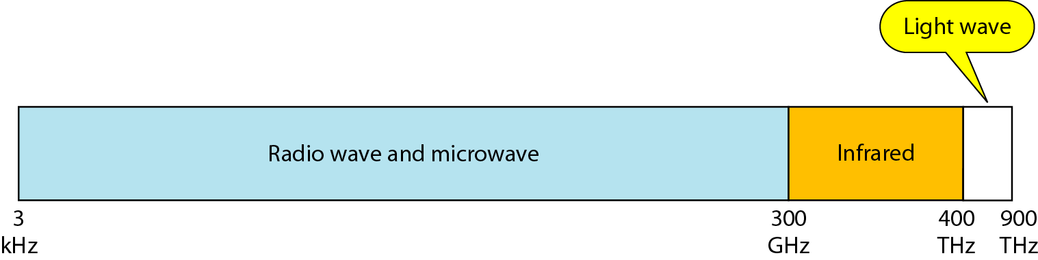
Figure : Electromagnetic spectrum for wireless communication

Slide 48
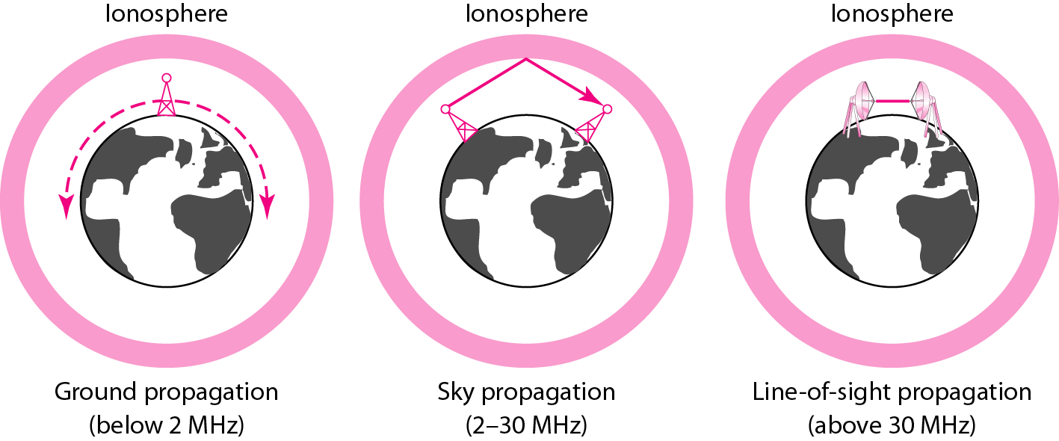
Figure : Propagation methods

Slide 49
Table . Bands

Slide 50
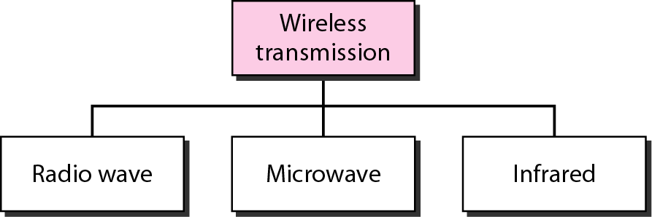
Figure . Wireless transmission waves

Slide 51
Radio Waves:
Although there is no clear-cut demarcation between radio waves and microwaves, electromagnetic waves ranging in frequencies between 3 kHz and 1 GHz are normally called radio waves; waves ranging in frequencies between 1 and 300 GHz are called microwaves.
Radio waves, for the most part, are omnidirectional. When an antenna transmits radio waves, they are propagated in all directions. This means that the sending and receiving antennas do not have to be aligned. A sending antenna sends waves that can be received by any receiving antenna.
Radio waves are used for multicast communications, such as radio and television, and paging systems.
They can penetrate through walls.
Highly regulated. Use omni directional antennas

Slide 52
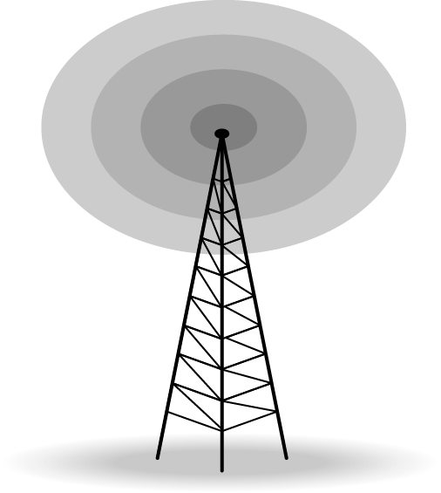
Figure : Omnidirectional antenna

Slide 53
Microwaves
Microwaves are unidirectional. When an antenna transmits microwaves, they can be narrowly focused. This means that the sending and receiving antennas need to be aligned.
Microwave propagation is line-of-sight. Since the towers with the mounted antennas need to be in direct sight of each other, towers that are far apart need to be very tall.
The curvature of the earth as well as other blocking obstacles do not allow two short towers to communicate by using microwaves. Repeaters are often needed for longdistance communication.
Microwaves are used for unicast communication such as cellular telephones, satellite networks,and wireless LANs.
Higher frequency ranges cannot penetrate walls.
Use directional antennas - point to point line of sight communications.

Slide 54
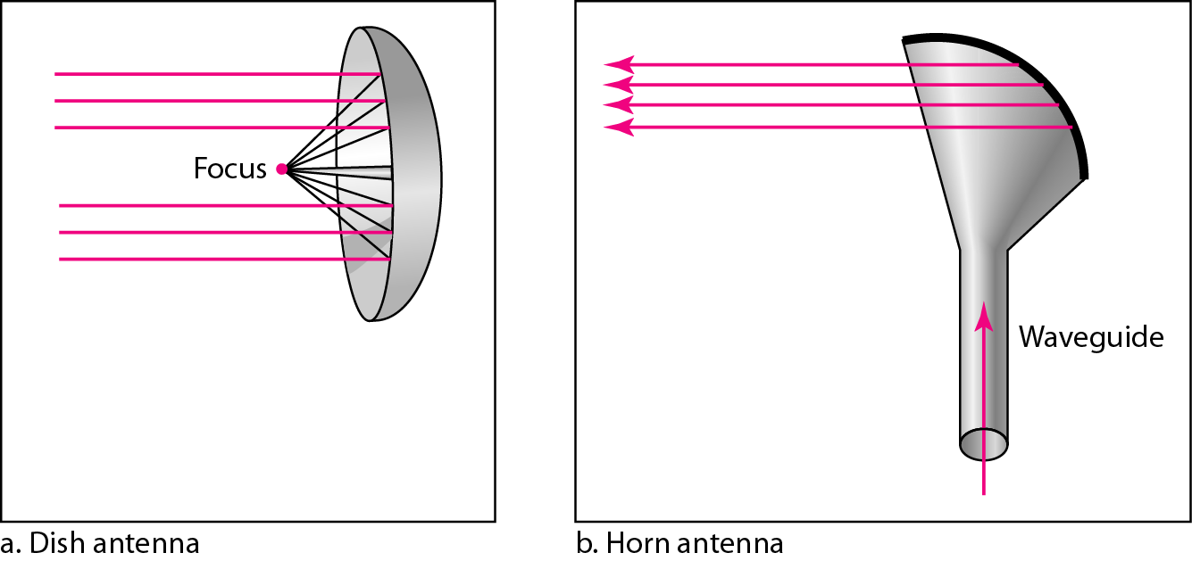
Figure . Unidirectional antennas

Slide 55
Infrared:
Infrared waves, with frequencies from 300 GHz to 400 THz (wavelengths from 1 mm to 770 nm), can be used for short-range communication.
Infrared waves, having high frequencies, cannot penetrate walls.
This advantageous characteristic prevents interference between one system and another; a short-range communication system in one room cannot be affected by another system in the next room.
Infrared signals can be used for short-range communication in a closed area using line-of-sight propagation.

